Slide 1
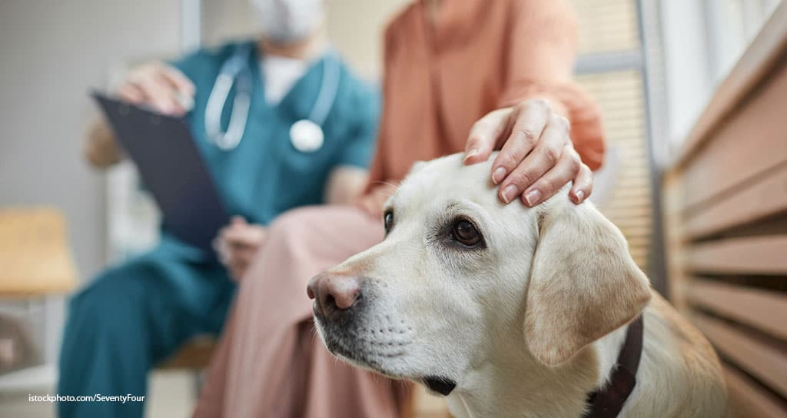
Anesthetic risk assessment
Assist. Prof. Dr. Rafid Majeed Naeem

Slide 2
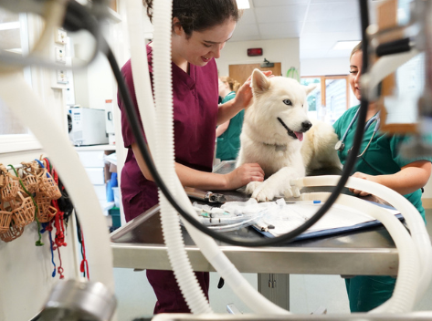

Anesthetic risk assessment
perioperative assessment of anesthetic risk is a valuable exercise in order to
minimize complications and
optimize anesthetic safety.
The preoperative assessment of an animal’s health status is valuable to:
1. to acknowledge preanesthetic risks,
2. to identify management priorities
3. to advise clients appropriately prior to anesthesia and surgery

Slide 3
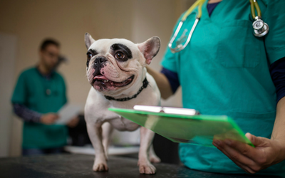
مهمPatient health assessment include
Pre‐existing cardiopulmonary pathology
Hematologic and biochemical abnormalities
Renal disease
Neurologic disease

Slide 4
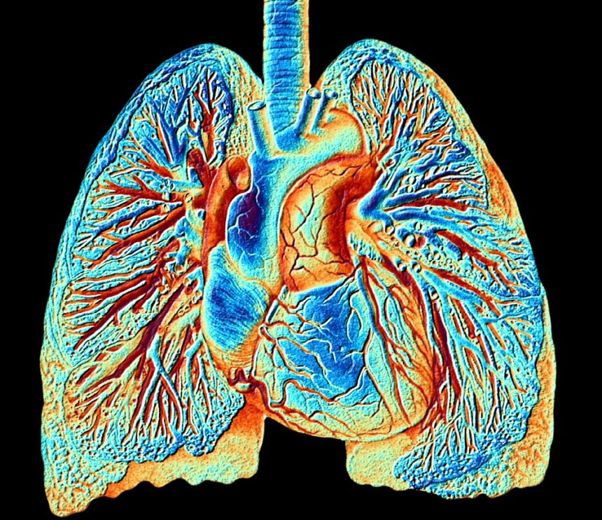
1. Pre‐existing cardiopulmonary pathology
Anesthetic agents cause cardiopulmonary depression and the presence of pre‐existing pathology is likely to predispose to greater anesthetic‐induced physiologic disturbance and may considered as anesthetic‐related mortality
تسبب عوامل التخدير التثبيط القلبي الرئوي ومن المرجح أن يؤدي وجود أمراض موجودة مسبقًا إلى حدوث اضطرابات فسيولوجية ناتجة عن التخدير وقد تعتبر بمثابة وفيات مرتبطة بالتخدير

Slide 5
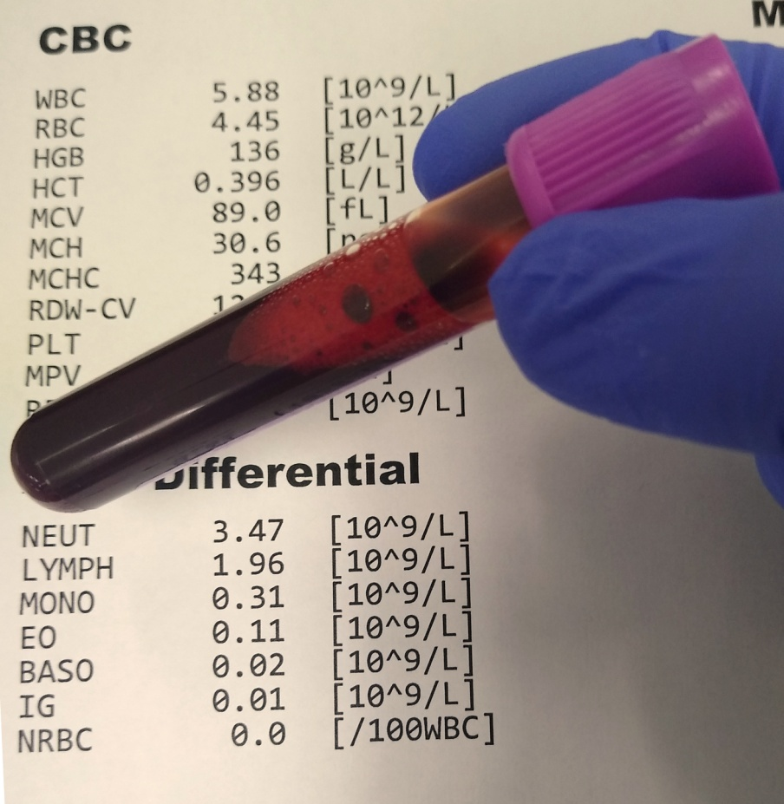
2. Hematologic and biochemical abnormalities In particular,
anemia will reduce oxygen carrying capacity and predispose to hypoxia, and
hypoproteinemia has been theorized to increase the response of the patient to highly protein‐bound drugs and result in relative overdose.
the laboratory biochemical or hematologic results are useful for
a. identifying that surgery should be postponed
b. Changing anesthetic protocol,
c. undiagnosed pathology may be detected prior to anesthesia using ‘routine’ screening may useful for whether the owner decides to proceed with anesthesia/surgery

Slide 6
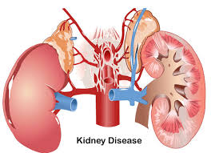

3. Renal disease is also important, if dehydration or uremia is present
4. Neurologic disease the occurrence of postoperative seizures, increased sensitivity to anesthetics

Slide 7
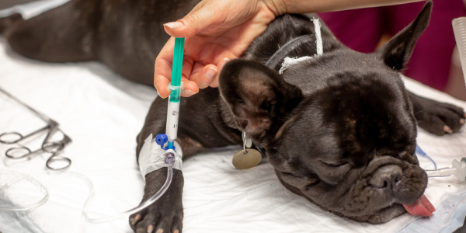
Morbidity and mortality
Morbidity; Nonfatal complications tend to occur more frequently than mortal events.
Small animal anesthesia morbidity:
are non‐fatal complications which include
Respiratory complications
cardiovascular complications
gastrointestinal,
thermoregulatory,
Poor recoveries

Slide 8
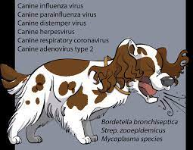
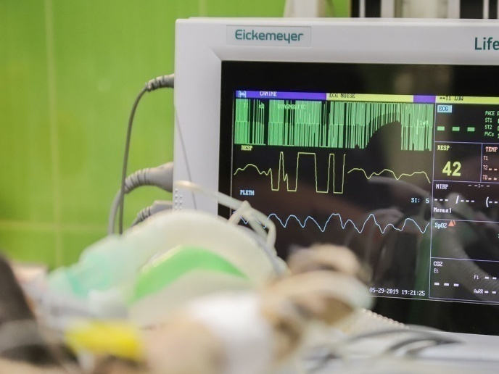
Respiratory complications included respiratory depression or apnea, respiratory distress, and difficulty with intubation, hypoventilation and hypercapnia and hypoxemia , occasionally airway compromise
تضمنت المضاعفات التنفسية تثبيط الجهاز التنفسي أو انقطاع النفس ، وضيق التنفس ، وصعوبة التنبيب ، ونقص التهوية ، وفرط ثنائي أكسيد الكربون في الدم ، ونقص الأكسجة في الدم ، وفي بعض الأحيان اختلال في مجرى الهواء
2. cardiovascular complications were hypotension and cardiac arrhythmias notably bradycardia
كانت مضاعفات القلب والأوعية الدموية هي انخفاض ضغط الدم وعدم انتظام ضربات القلب بشكل خاص بطء القلب

Slide 9
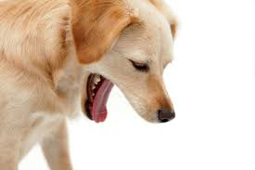


3. Regurgitation was the most frequently documented perioperative gastrointestinal complication.
The risk of gastroesophageal reflux, which may result in esophageal mucosa injury
4. Hypothermia, was a particularly common complication.
5. Poor recoveries have also been documented, often recorded as prolonged return to consciousness.

Slide 10
Large animal anesthesia morbidity (non‐fatal complications)
1. Cardiovascular compromise (same as small animals)
2. Respiratory …hypoventilation and hypercapnia and hypoxemia
على نقص التهوية وفرط ثنائي أكسيد الكربون ونقص الأكسجة في الدم
3. In contrast to small animal anesthesia, horses appear to demonstrate a wider range of postoperative complications, including fractures and soft tissue injury like myopathy, and neuropathy and many result in death or euthanasia.
على عكس التخدير الحيواني الصغير ، يبدو أن الخيول تظهر نطاقًا أوسع من مضاعفات ما بعد الجراحة ، بما في ذلك الكسور وإصابة الأنسجة الرخوة ، والاعتلال العضلي ، والاعتلال العصبي ويؤدي العديد منها إلى الموت أو القتل الرحيم.
4. postanesthetic colic

Slide 11
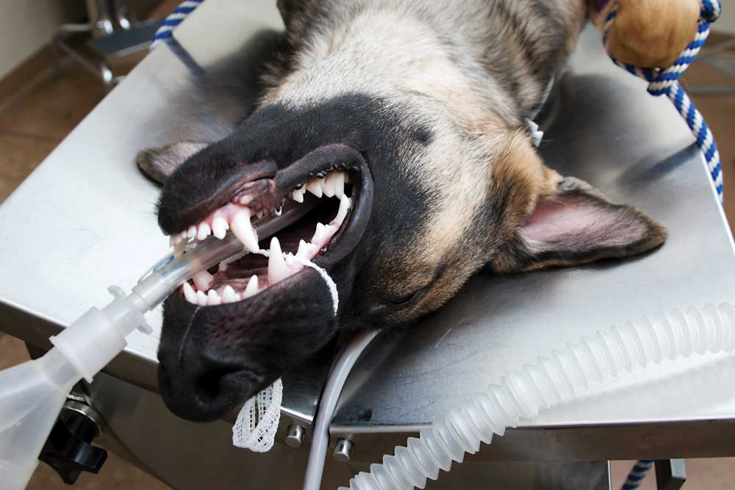
Small animal anesthetic fatalities
Causes of anesthetic death
The cause of anesthetic deaths:
cardiovascular and respiratory complications represent the primary causes of many perioperative deaths.
. Other causes:
postoperative renal failure,
aspiration of gastric contents,
anaphylactic reactions,
failure to regain consciousness,
unknown causes

Slide 12

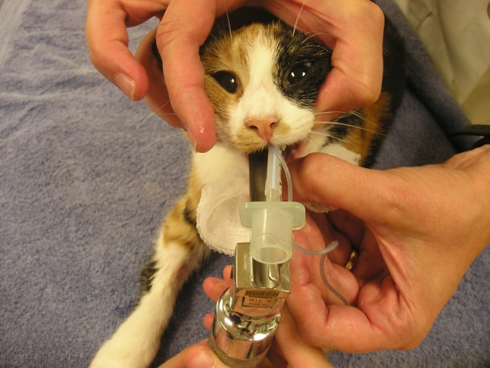
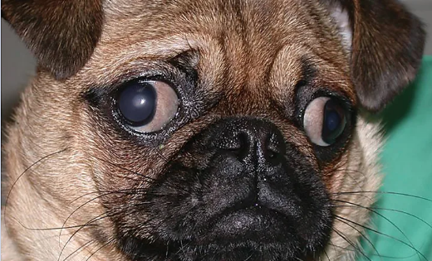
1. Cardiac arrest has been reported to result from cardiac arrhythmias associated with: increased circulating catecholamine, myocardial hypoxia, specific anesthetic agents, pre‐existing pathology, and myocardial depression due to relative anesthetic overdose.
Halothane, ether, and thiobarbiturate anesthesia were frequently associated with anesthetic overdose in earlier work.
2. Respiratory complications represented the other main cause of anesthetic‐related death .
Problems related to endotracheal intubation and respiratory obstruction represented the majority of feline respiratory causes of death.
In dogs, complications with endotracheal intubation and respiratory failure were equally reported, although in brachycephalic dogs respiratory obstruction was the principal cause of respiratory complications.

Slide 13

Timing of death
Death may occurred
during induction,
during maintenance of anesthesia
the majority during recovery.
the postoperative period represented a high‐risk time and close monitoring and management until full recovery is observed are to be recommended.

Slide 14

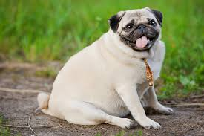
Risk factors for anesthetic death
1. brachycephalic, terrier, and spaniel breeds in dogs were frequently represented amongst the fatalities.
2. Old age and poor health status
3. increasing duration of the procedure
4. Pre‐existing pathology
5. procedural urgency
6. extremes of weight (risks associated with obesity)
7. endotracheal intubation
8. excessive administration of fluids and fluid overload.

Slide 15
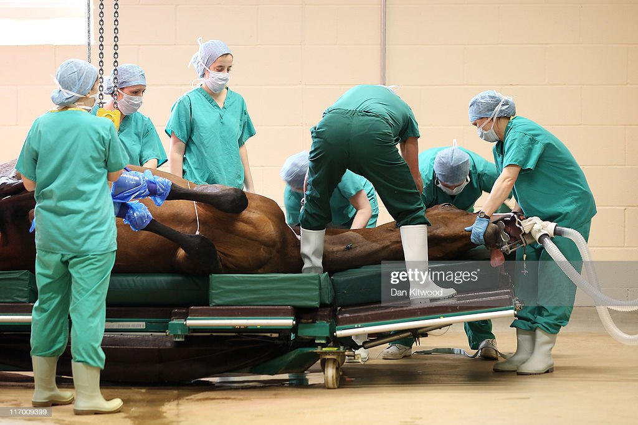
Large animal anesthetic mortality
Risk of anesthetic death
Many of these fatalities due to horses undergoing emergency gastrointestinal surgery that high‐risk patients

Slide 16
Causes of anesthetic death
In equine anesthesia, cardiac arrest and cardiovascular collapse were major causes of death,
Respiratory complications
Non‐cardiopulmonary causes: fractures on recovery, postoperative myopathy, and abdominal complications such as sepsis and colitis.
Rarely have horses been reported ‘found dead’ or dying of unknown cause, perhaps because horses are more closely observed on recovery than many small animal patients.

Slide 17
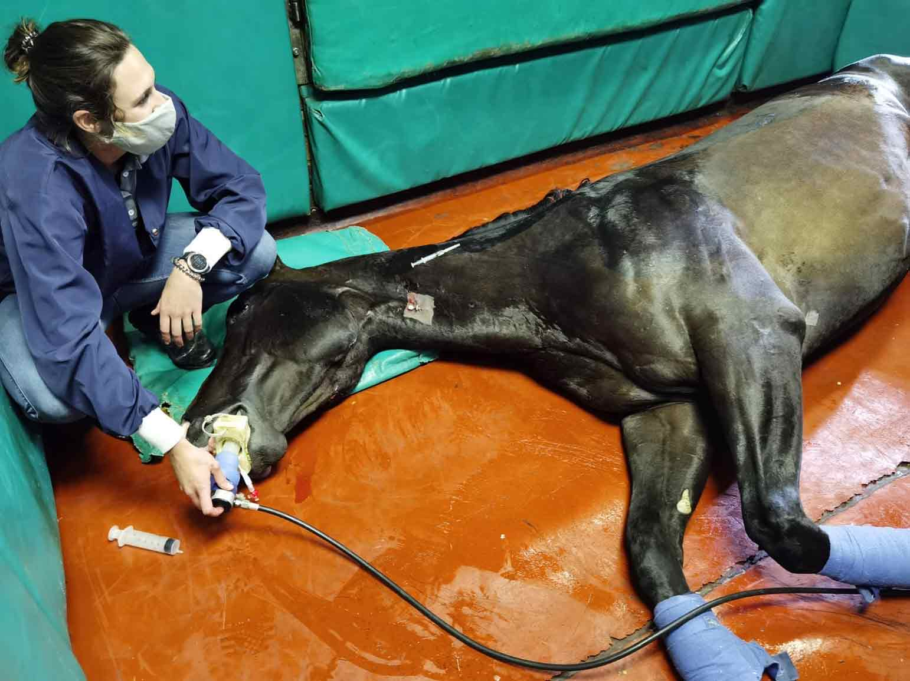
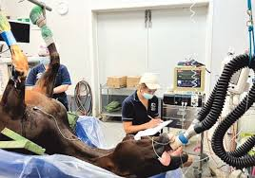
Timing of anesthetic death
the postoperative period as a major period of risk, although intraoperative concerns remain important, close attention to the postoperative period is also important in equine anesthesia.

Slide 18

commonly reported risk factors associated with death
The work in equine anesthesia indicates risk factors include
1. emergency,
2. abdominal, and orthopedic surgery,
3. long operations,
4. poor health status,
5. extremes of age
Informed consent موافقة مسبقة
the successful communication of these risks to owners and clients is central to the provision of safe anesthesia and the maintenance of realistic owner expectations.
يعتبر التواصل الناجح لهذه المخاطر مع المالكين والعملاء أمرًا محوريًا لتوفير التخدير الآمن والحفاظ على توقعات واقعية للمالك.

Slide 19


